Slide 1


Coupon Acceptance Analysis
This project analyzes customer behavior in coupon redemption using demographic data, purchase history, and coupon details. After preprocessing the data, machine learning models were applied to predict coupon acceptance based on factors like age, income, past purchases, and coupon type. The insights aim to optimize promotional strategies and improve targeting.

Slide 2

Data overview
1
Data Size
The dataset contains 12,684 rows and 25 columns, with 24 independent features and 1 dependent variable.
Key features influencing the target variable include expiration, weather, coupon, passenger, destination, income, and age.
2
3
The target variable indicates whether a coupon was accepted or not, represented by the column "Accept (Y/N)".

Slide 3
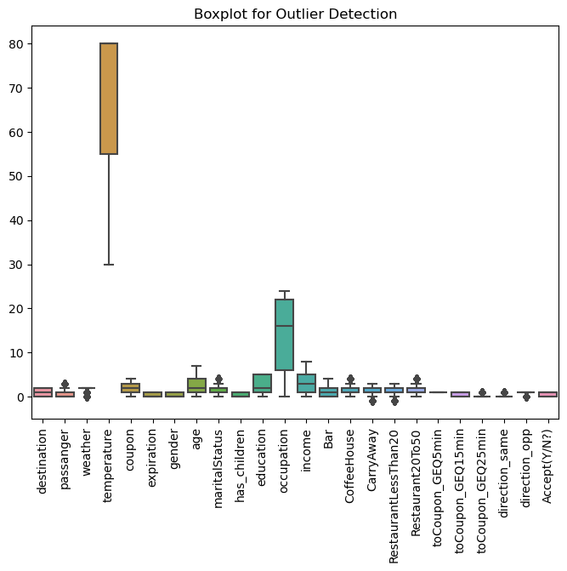
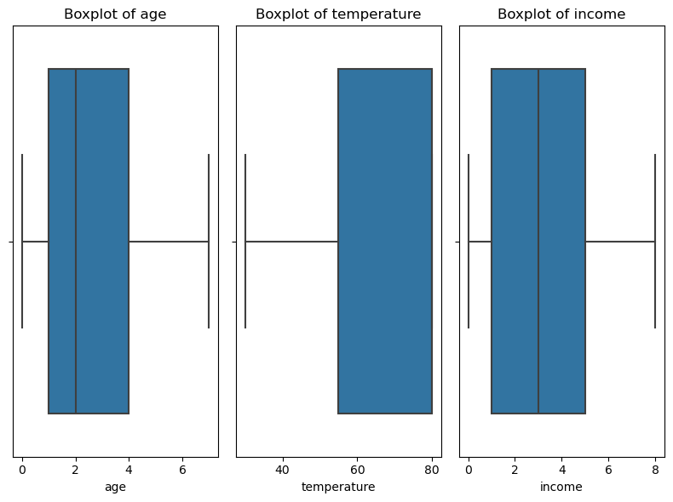
Data preprocessing
Data Cleaning:
Handle missing values
Remove duplicates
Detect and treat outliers
Data Transformation:
Normalize/Standardize numerical features
Encode categorical variables (One-Hot, Label Encoding)
Feature Engineering:
Select relevant features
Data Splitting:
Split data into training and test sets (e.g., 80/20)

Slide 4
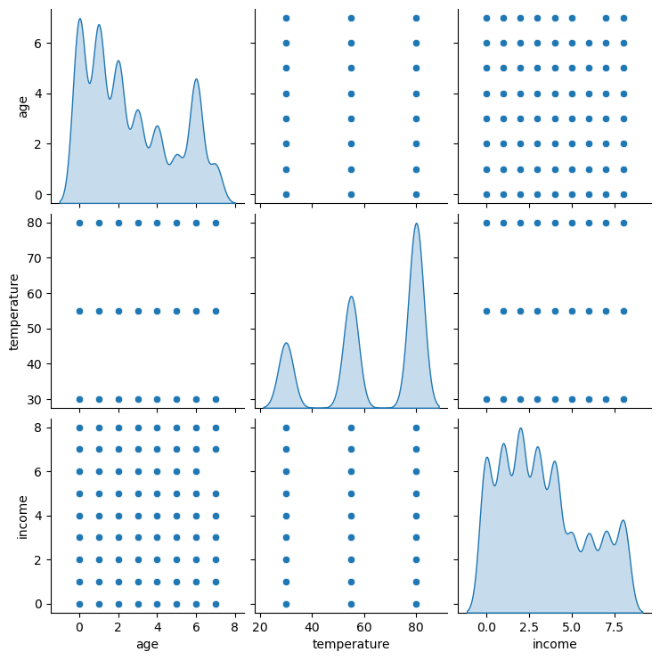
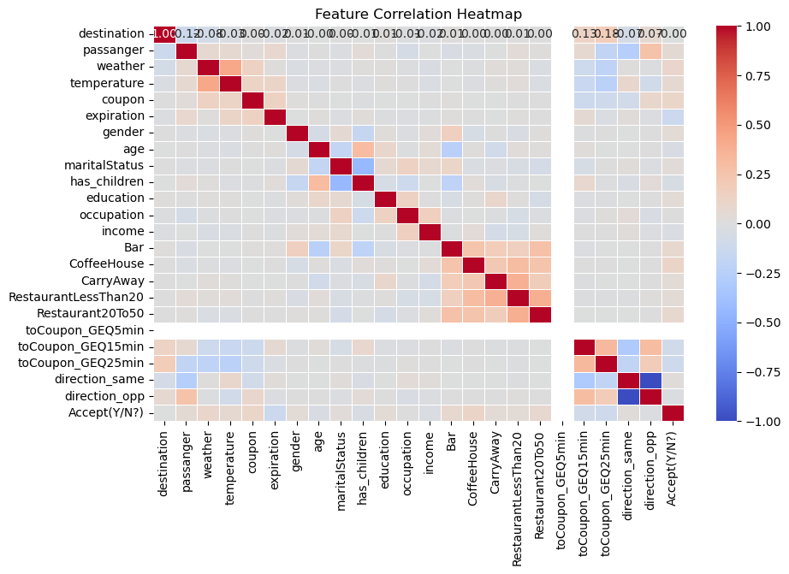
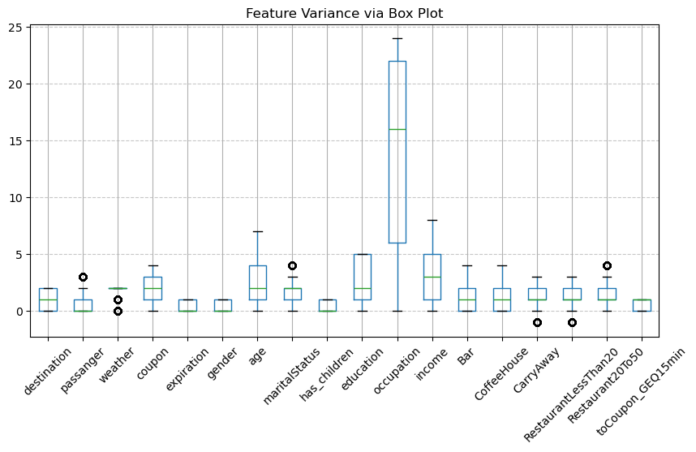
Exploratory data Analysis
Correlation Matrix: Displays the relationships between different features in the dataset. Strong correlations can provide insight into how features interact, helping identify important variables for prediction.
Variance: Shows the distribution of feature values. Features with high variance may carry more information, while features with low variance could be less impactful or redundant.
Pairplot: Visualizes the pairwise relationships between all numerical features, allowing us to spot patterns, trends, and potential outliers, which are crucial for understanding the data before building a model.

Slide 5

Model selection for classification problem
Logistic Regression – A simple yet effective classification model that estimates the probability of coupon acceptance based on customer features.
Random Forest-A powerful ensemble method for capturing complex, non-linear relationships in data.
Support Vector Classifier (SVC) – A model that finds the optimal boundary to classify whether a customer will accept the coupon, even in high-dimensional spaces.
XGBoost Classifier: Achieved the highest accuracy, effectively capturing complex patterns for better coupon acceptance prediction.
Gradient Boosting Classifier: Delivered strong performance by sequentially improving weak models, enhancing prediction accuracy.
GridSearchCV- Used to fine-tune hyperparameters and optimize model performance by exhaustively searching the best parameter combinations.

Slide 6
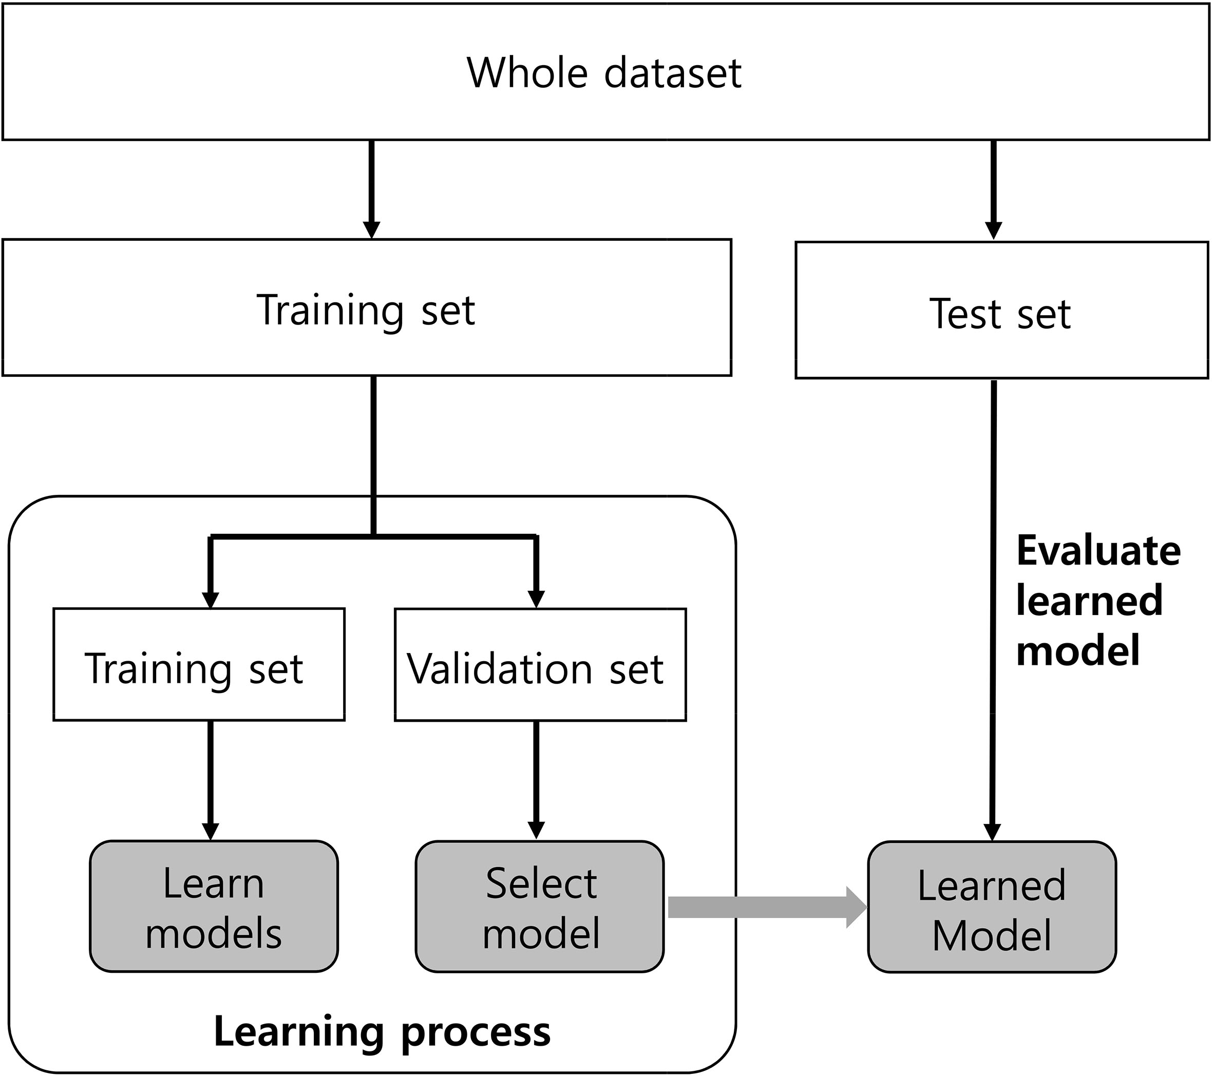
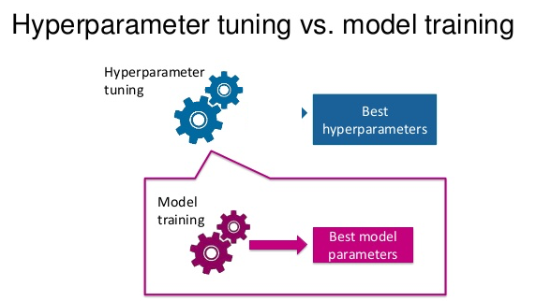
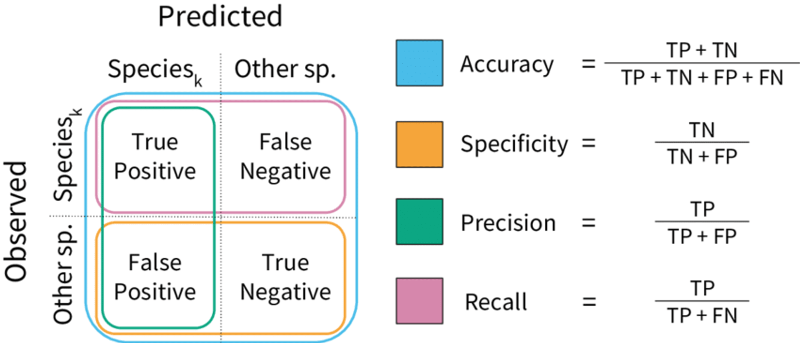
Model training and evaluation
1.The model evaluation is done using an 80% training and 20% testing split.
2.GridSearchCV was utilized for hyperparameter tuning of the model.
3.Model evaluation is based on precision, recall, F1-score, and the confusion matrix to measure classification performance.

Slide 7
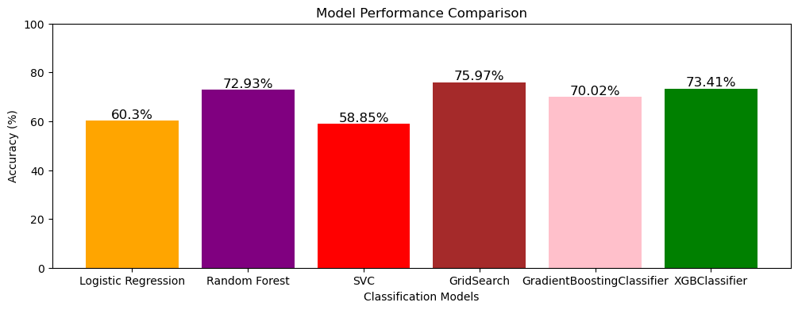
Best performer
GridSearchCV: Achieved the highest accuracy of 75.97% by optimizing hyperparameters, leading to improved model performance.
Runner-up
XGBoost Classifier: Achieved the highest accuracy of 73.42%, effectively handling complex relationships in the data.
Baseline model
Logistic Regression: Performed with an accuracy of 60.03%, offering a good baseline model for comparison

Slide 8
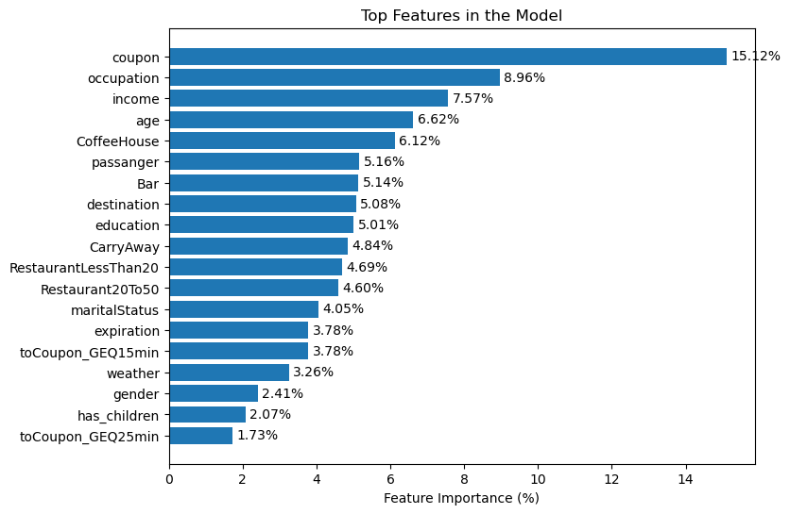
"Top Features Contributing to the Model"
Coupon
Important feature which holds 15.12%
Occupation
It holds 8.96% of importance
Income
It holds 7.57% of important features
Followed by age , coffeehouse , passenger etc

Slide 9

"Summary of Key Discoveries in the Coupon Acceptance Project"
Best Model
"XGBoost Classifier outperformed other models in predicting coupon acceptance, demonstrating higher accuracy and robustness in classifying whether a coupon will be accepted or not."
Important Features
Coupon, expiration, income, age, and occupation significantly influence coupon acceptance, with certain factors like income and expiration playing a stronger role in determining whether a coupon will be accepted."
Model Accuracy
Achieved 75.91% accuracy in predicting coupon acceptance .

Slide 10


